Slide 1
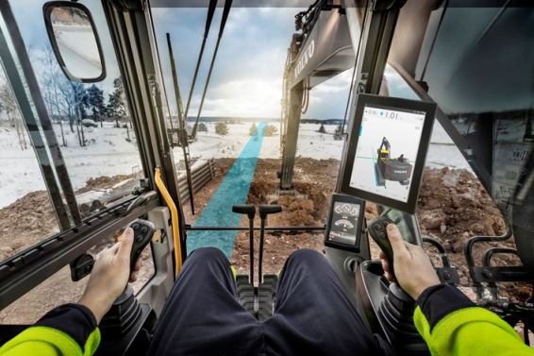
Co Pilot driver statistics project
11/18/2016
Team members:
Vladimir Djukanovic
Leslie Dahlberg
Léa Brunschwig
Eric Engtorp
Fredrik Frenning
Pooria Ghavamian
Hamza Sabljakovic

Slide 2
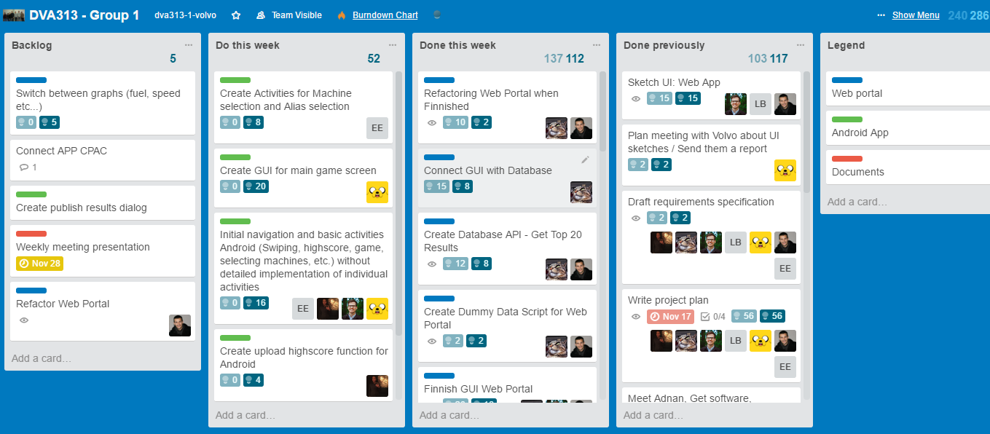
Trello – last week

Slide 3
Last week - establishments
Project plan presentation (Wednesday at 21:00)
Most of the web portal implementation:
Database
Create database schema
Insert dummy data
GUI
Add radial graph to the web portal
Finish GUI implementation
Functionality
Connection with database
Get top 20 high scores from database
Connect GUI with data retrieved from database
Refactor
Web hosting service
Android application:
Create algorithm for score and determine what data to measure and store
Create activity for high score
Set up SQL lite
Create activities for time selection

Slide 4
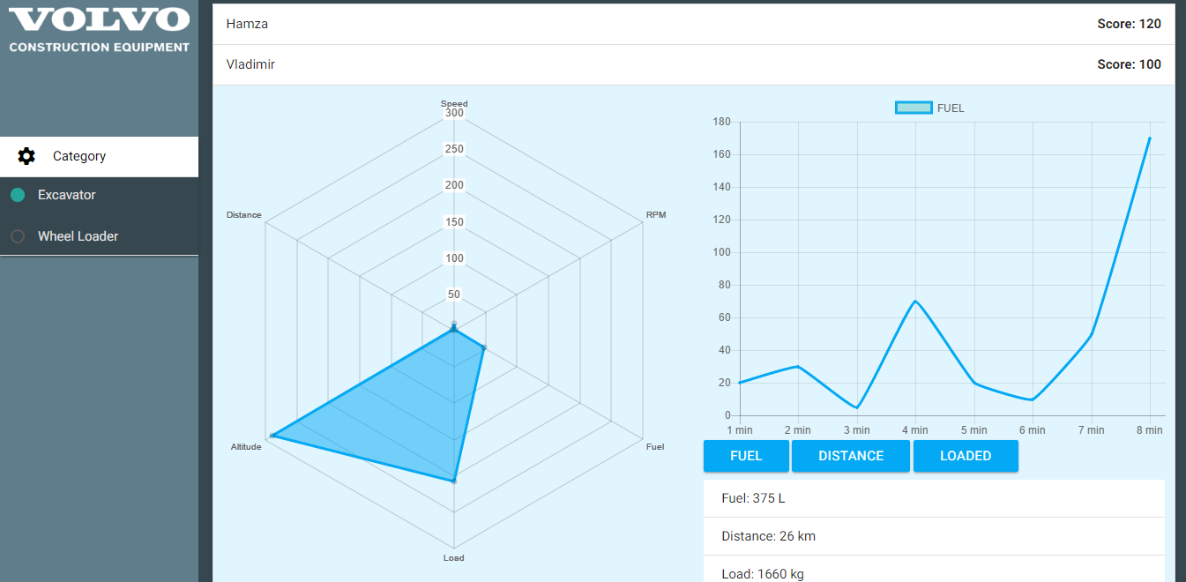
Web portal solution

Slide 5

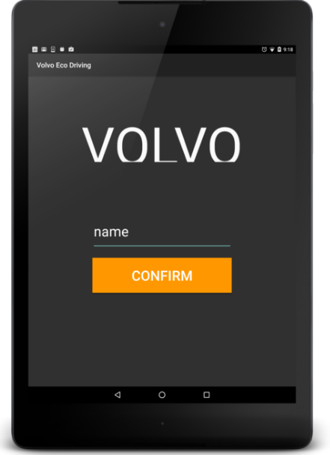
Select machine and alias screen

Slide 6
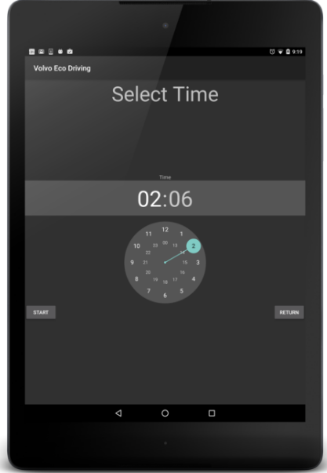
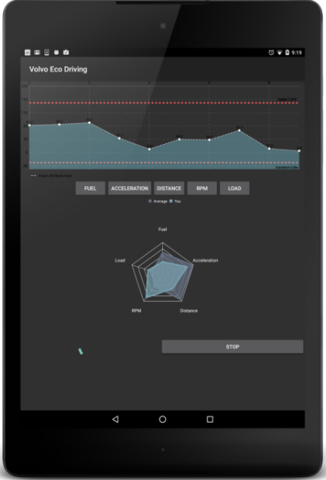
Select time and game screen

Slide 7
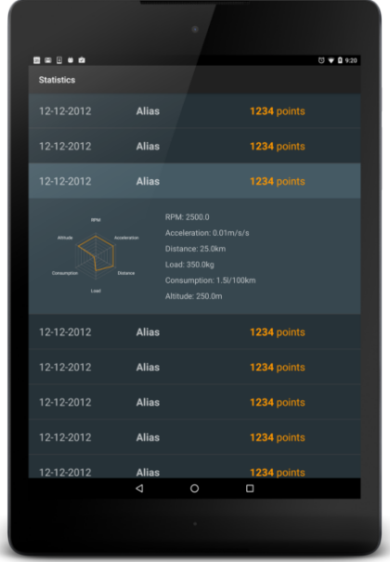
Scores – historic data

Slide 8
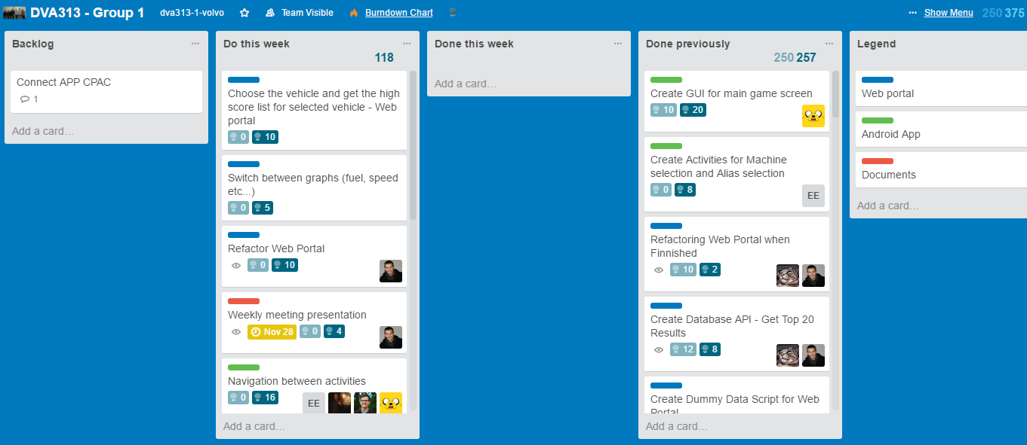
Trello – following week

Slide 9
Plan for following week
Implementation:
Web Portal implementation:
Switch between graphs (fuel, speed etc...)
Refactor when finish
Show high scores based on selected vehicle
Android application implementation:
Initial navigation and basic activities Android (Swiping, highscore, game, selecting machines, etc.) without detailed implementation of individual activities
Create upload highscore function for Android
Create GUI for main game screen
Create activities for machine selection and alias selection
Retouch of GUI for app
Navigation between activities
Upload high score function for Android
Publish results dialog
Design description – preliminary document
Short description - Lea
High-level description - Eric
Software architecture - Hamza
Detailed software design - Leslie
Graphical User Interface - Vladimir
Concerns - Fredrik
Review - Pooria

Slide 10
Obstacles
Co Pilot responsiveness
Different GUI in compare with standard Android

Slide 11
Worked hours
Name | Last week | Total
Vladimir Djukanovic | 27 | 57
Hamza Sabljakovic | 27 | 57
Léa Brunschwig | 0 (L) | 30
Eric Engtorp | 20 | 55
Fredrik Frenning | 20 | 55
Pooria Ghavamian | 20 | 55
Leslie Dahlberg | 20 | 55
Legend: L = on leave (approved by the group)

